Slide 1
Visually UXposed
June 10th, 2016 – Final presentation
hAkim & Ivan

Slide 2

The Domain Expert
uxprobe is a tech start up developing expertise in user experience measurement
Targets IT managers for application improvement
Tracks how users interact with the software in real time
Measures success and satisfaction of users in context
Paul Davies, co-founder of uxprobe was our domain expert

Slide 3
The Goal and Tasks
Goal : Support the IT project manager in deciding what changes to make to an application
Changes such as: adding or removing features, changing structure, etc
Tasks : the IT manager evaluates user experience information,
investigates the way the user interacts with the application, his success and satisfaction
uses the visualisation tools provided by uxprobe
Our objective : design a novel visualisation tool

Slide 4
The Dataset
Dataset: session logs of truck drivers using a fleet management application
The structure of the data is
User ID (missing for 50% of the data)
Session ID
Task Name (ex: New Message Notification)
Event Name (ex: Notification: Open Message)
Event Type (screen, feature, error)
Time Stamp (! up to seconds)
Volume: 1.2 million records, 161 MB
Entities have exponentionally decreasing frequencies

Slide 5
The Project
Initial brainstroms before dataset
Obtain the dataset, first developments, explore
Meet with Expert for explanation, goals and tasks
Several iterations of brainstorms and designs
Several iterations of development, prototyping with hopes and setbacks
Validation with expert, final decision on design
Final development
Blogs, project updates, report, final presentation
150 hours of development, 1300 lines of code

Slide 6
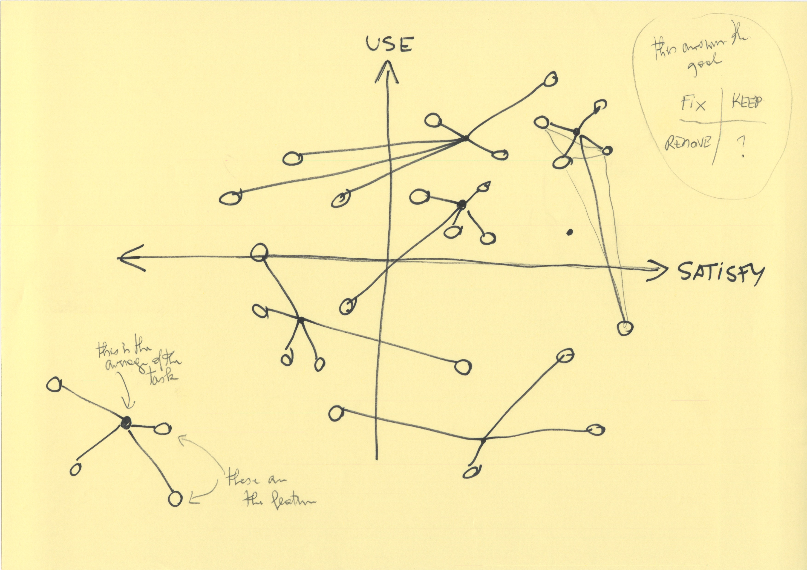
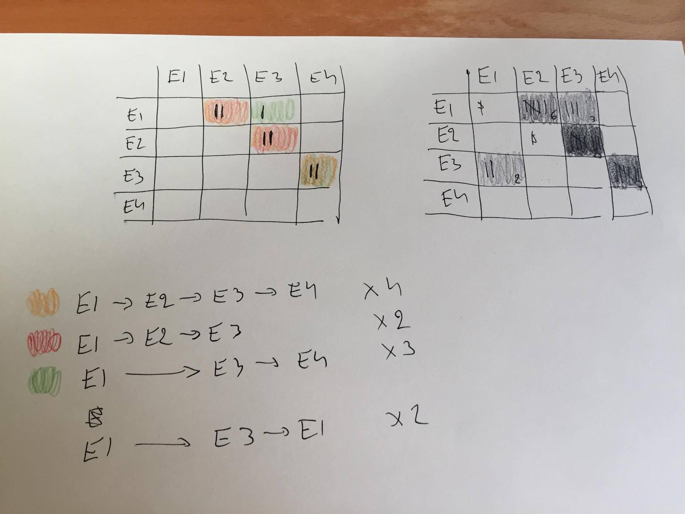
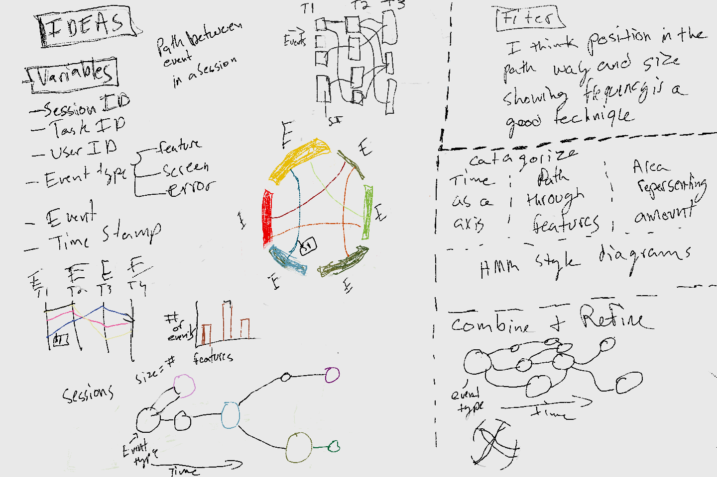
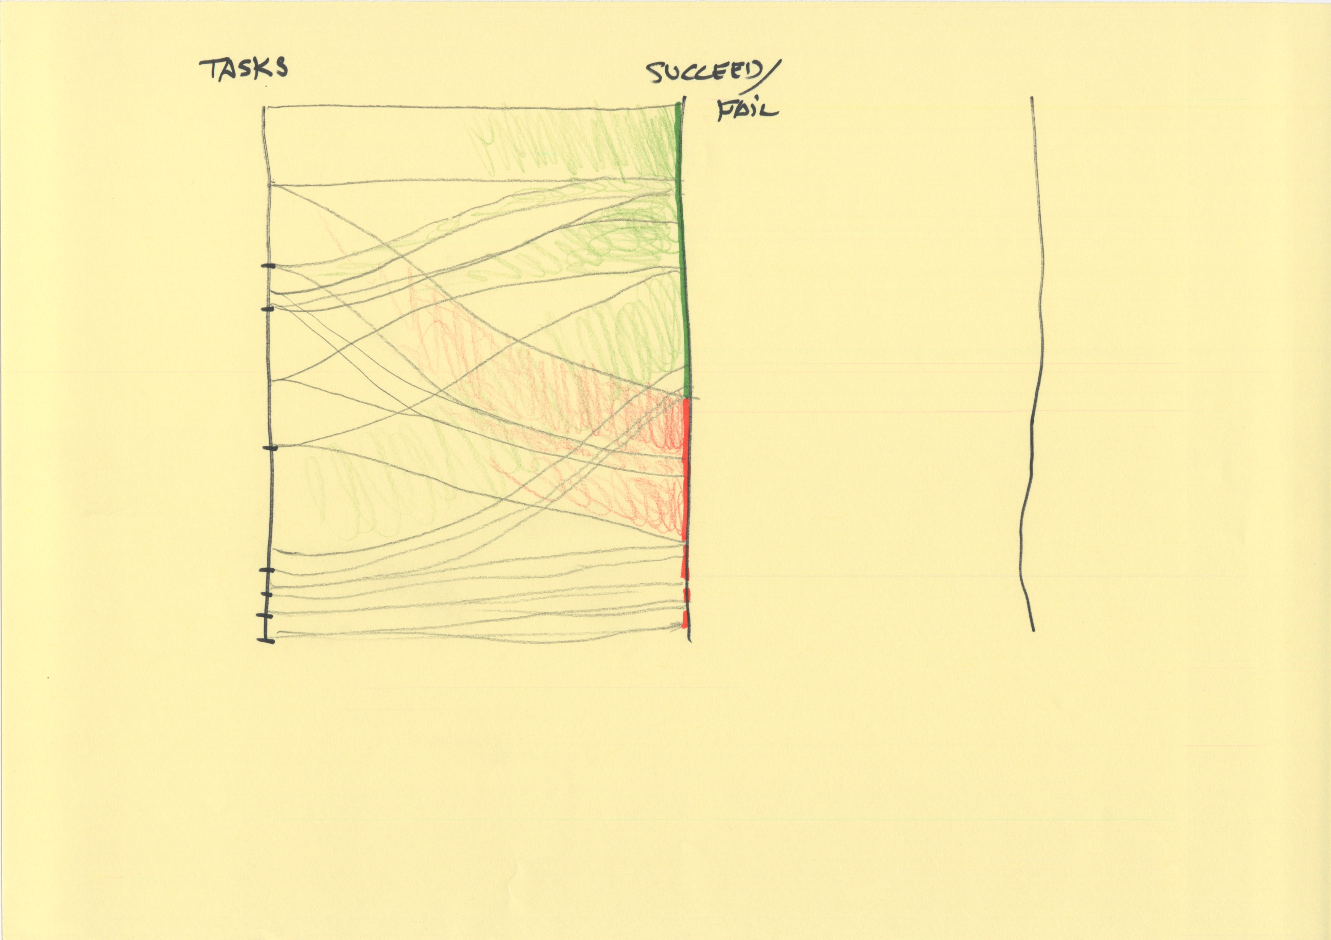
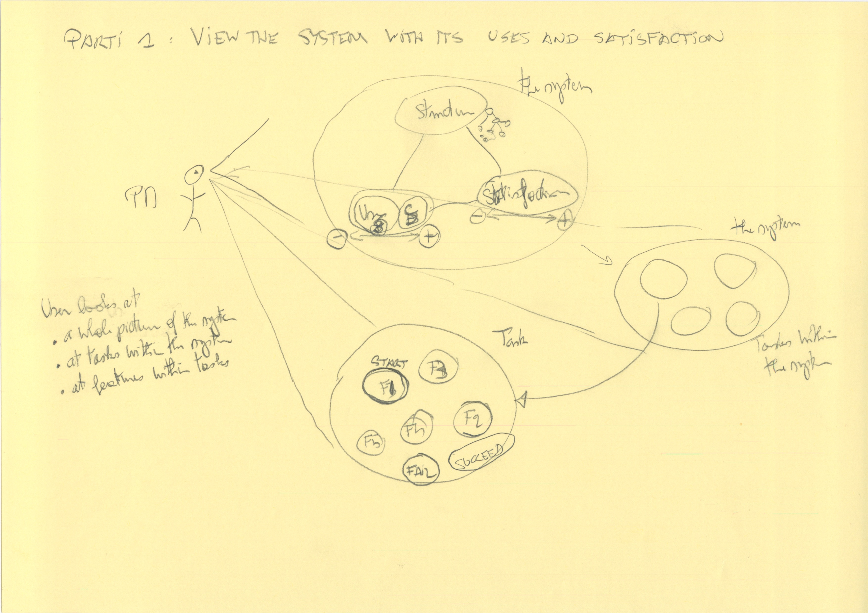
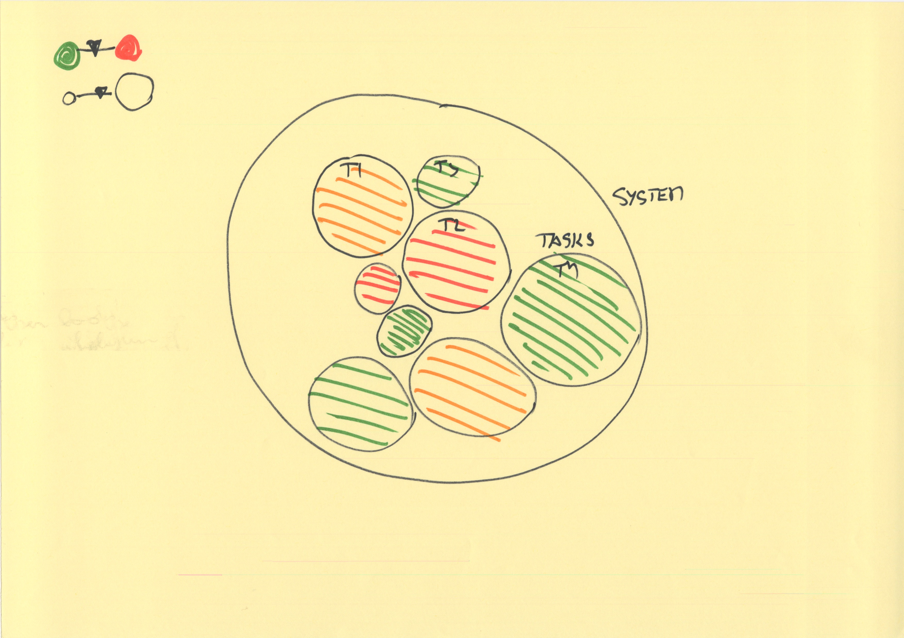
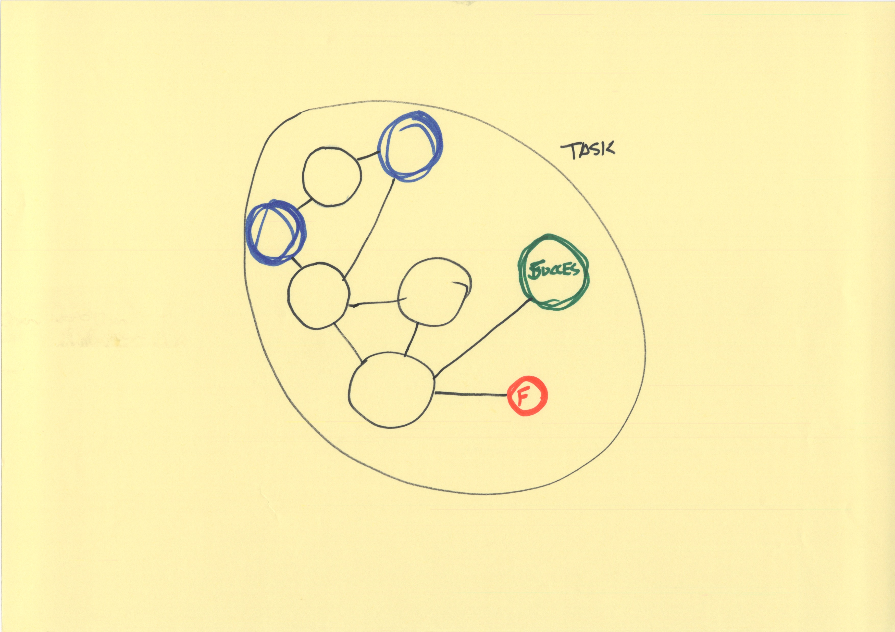
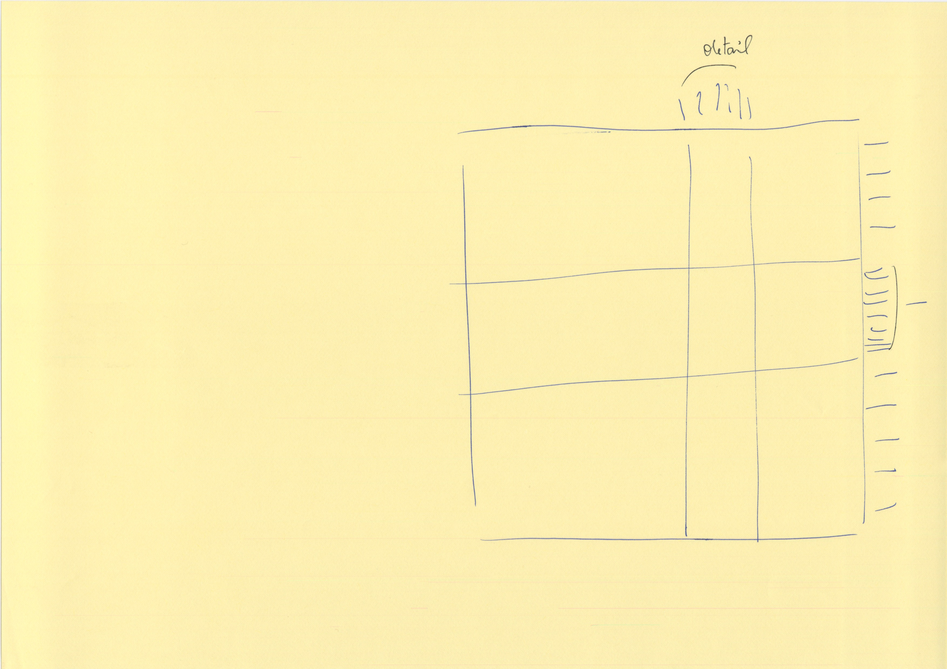
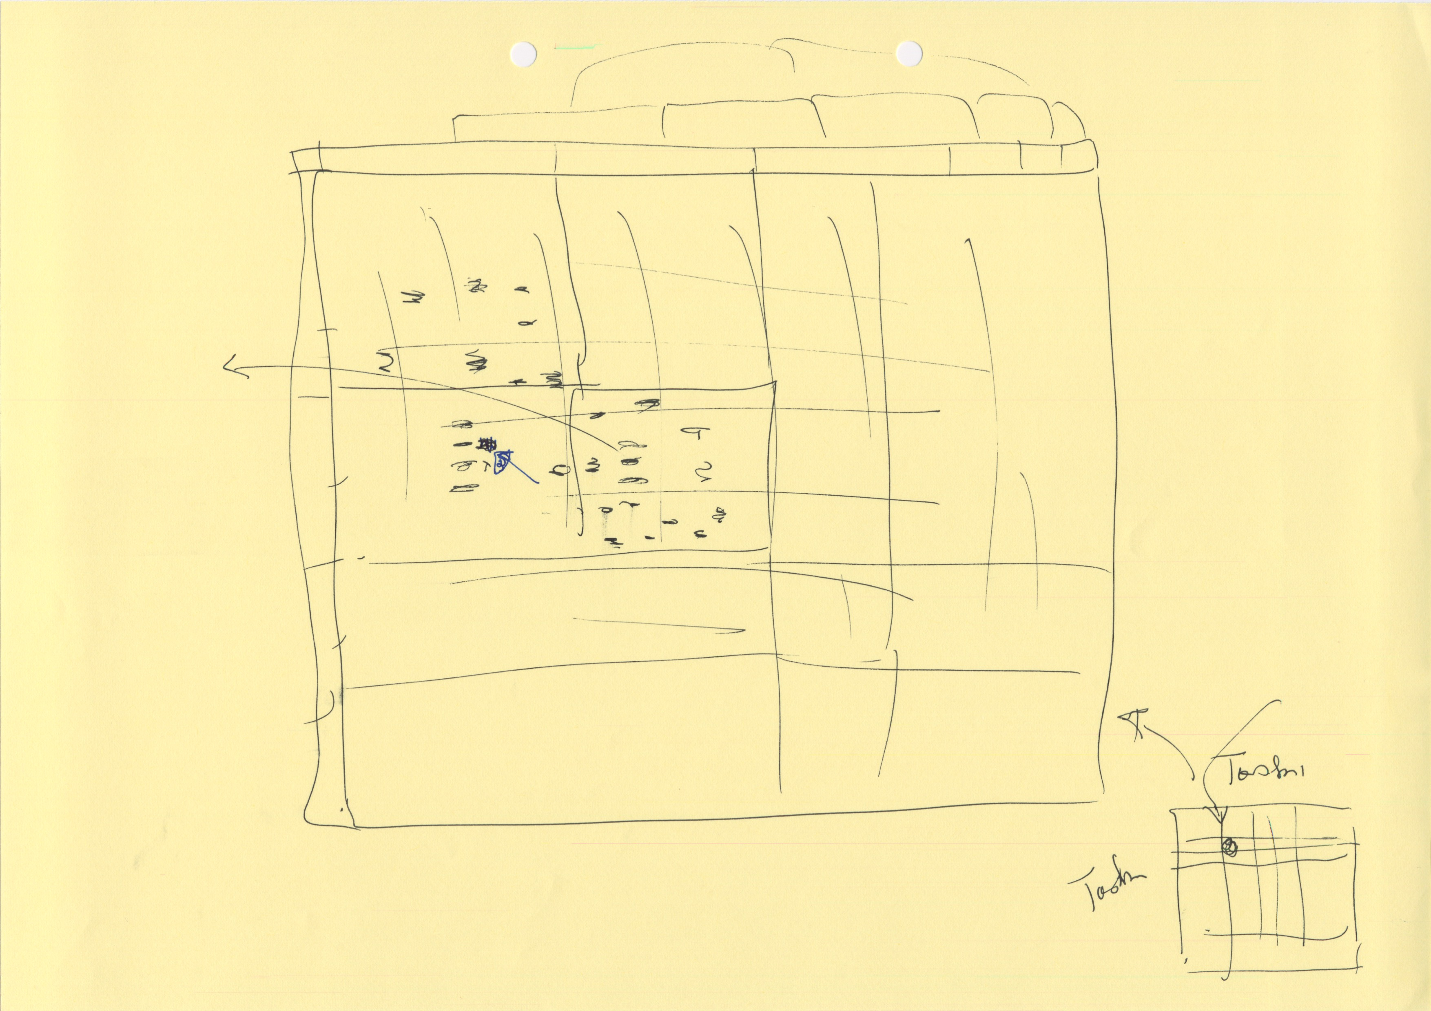
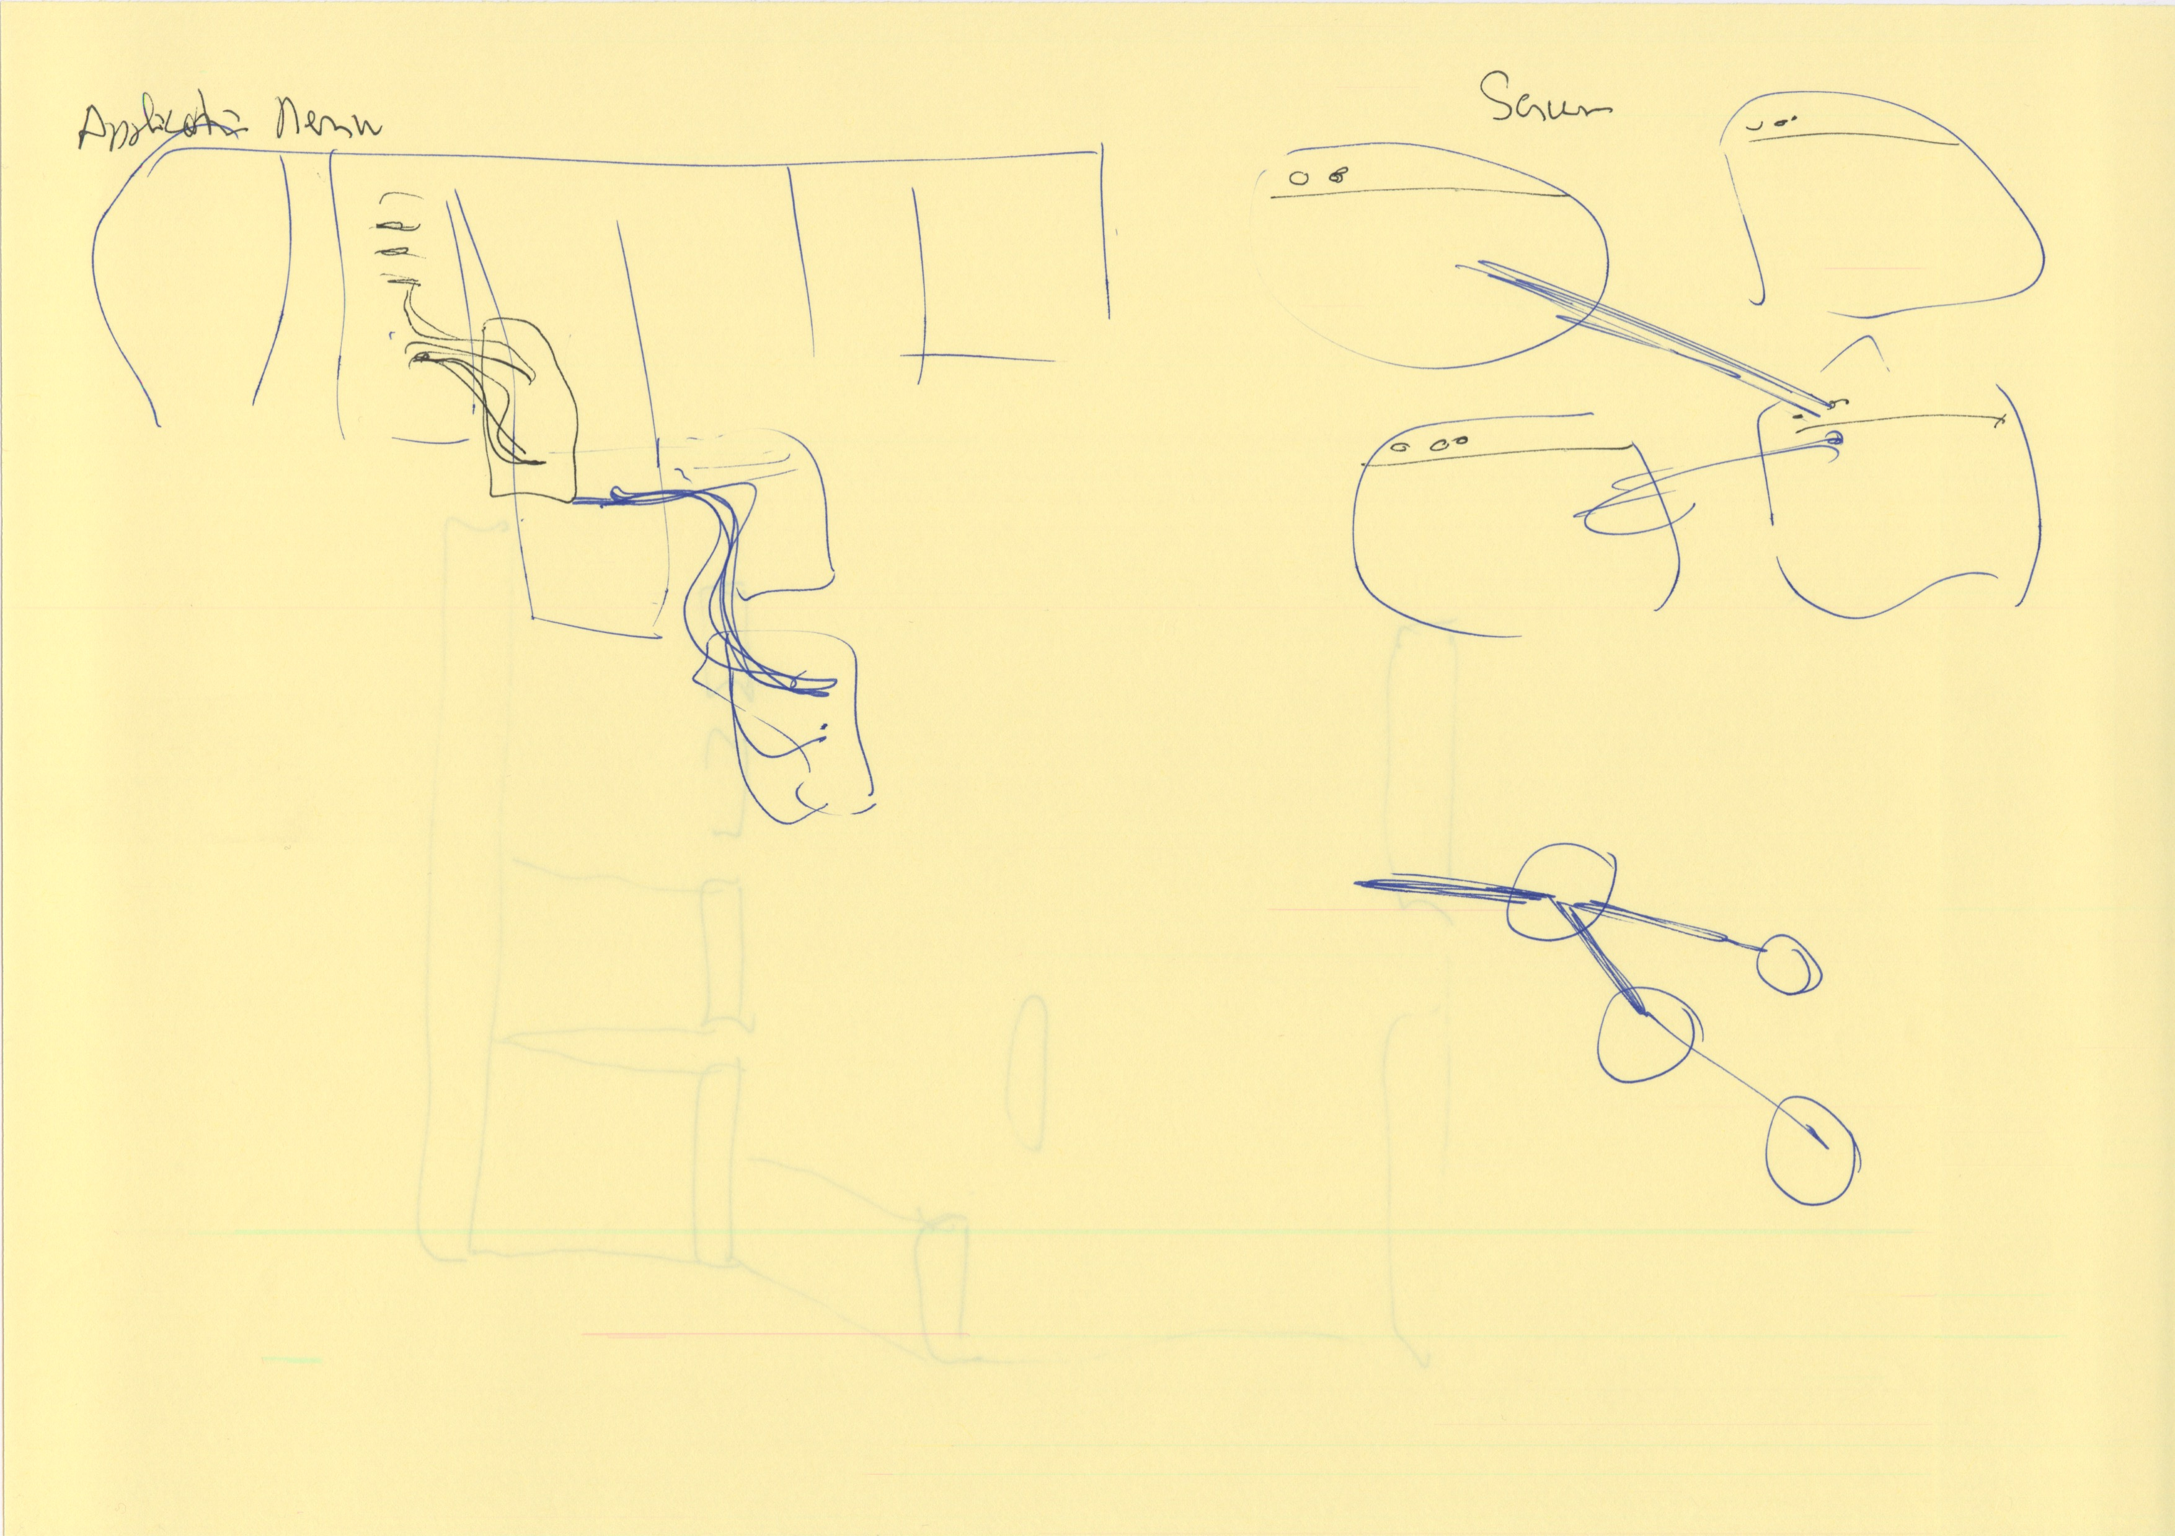
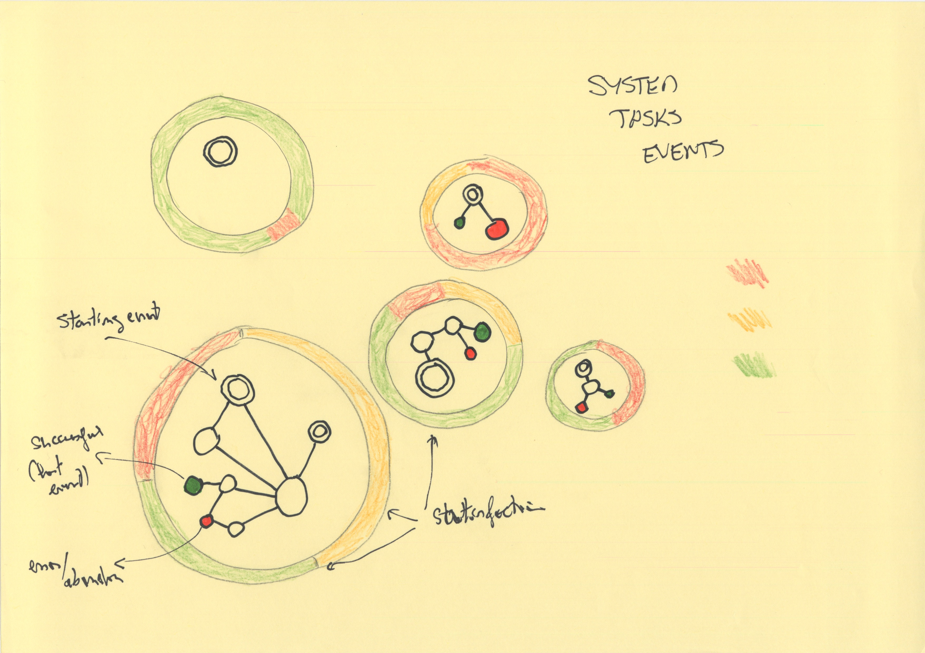
The Designs

Slide 7
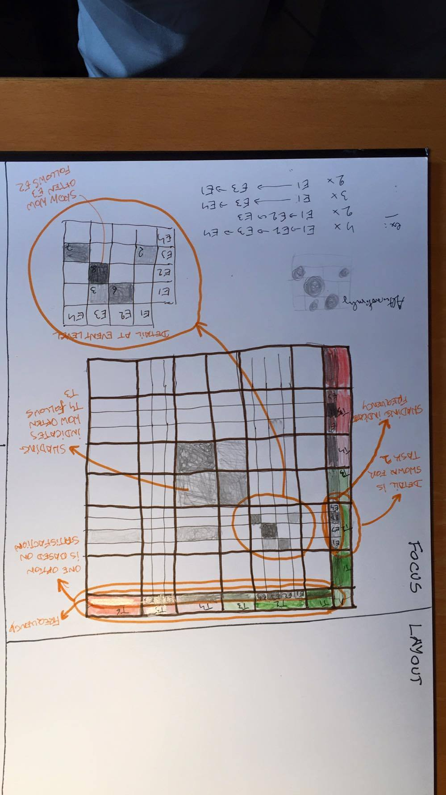
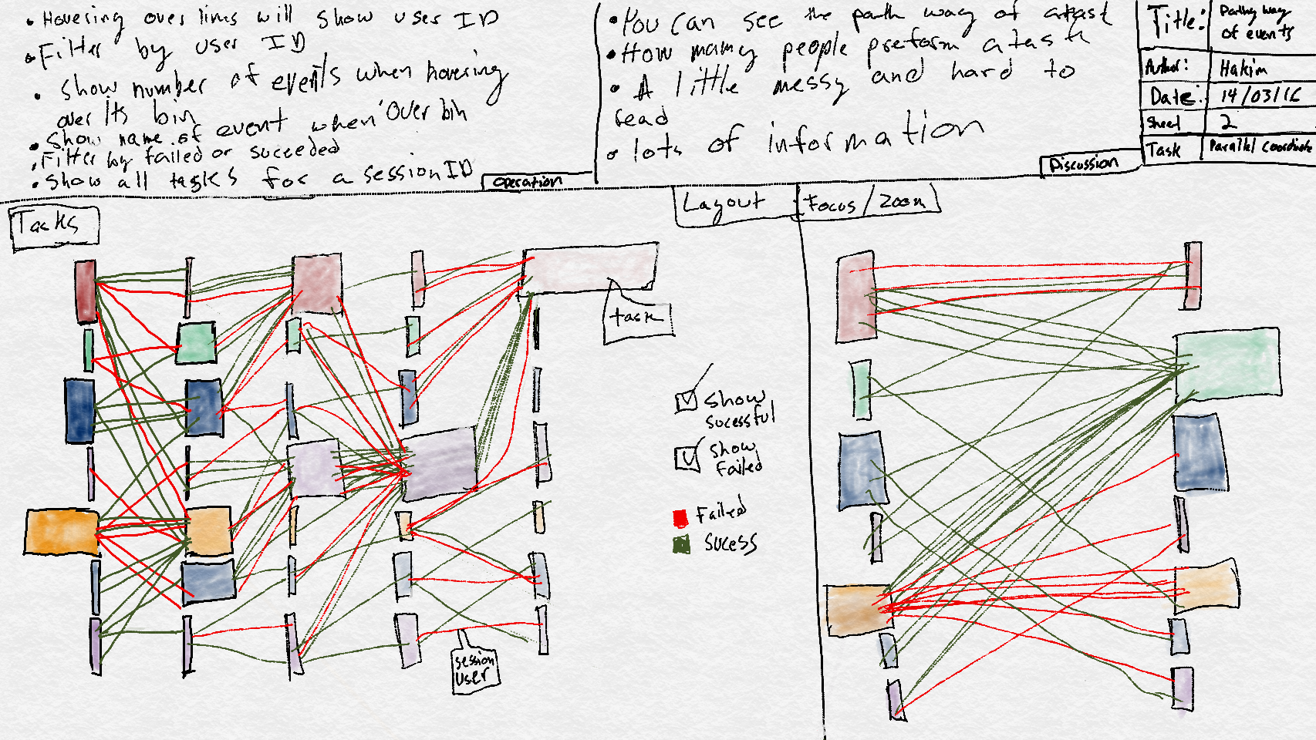
The Designs: 3 candidates

Slide 8
The Designs
Spheric representation of tasks, with graphs for events.
Issues: feasability (conflicting sizes, visibility), very complex implementation, missing data
A flow prespective, representing paths through the system
Issues: time perspective not so important for domain expert, conflicting tasks and events perspectives, sensitive to data issues, little satisfaction and error data, difficult to evaluate before a fairly complex implementation
!!! A Sankey flow already exists at UXprobe, so we didn’t consider this
A network perspective, vizualized in form of a matrix, combining task and event levels
Plus: robustness to data issues and missing data, handles well the task/event hierachy, manageable implementation, etc
Our favored design
Usefulness and choice confirmed with the domain expert

Slide 9
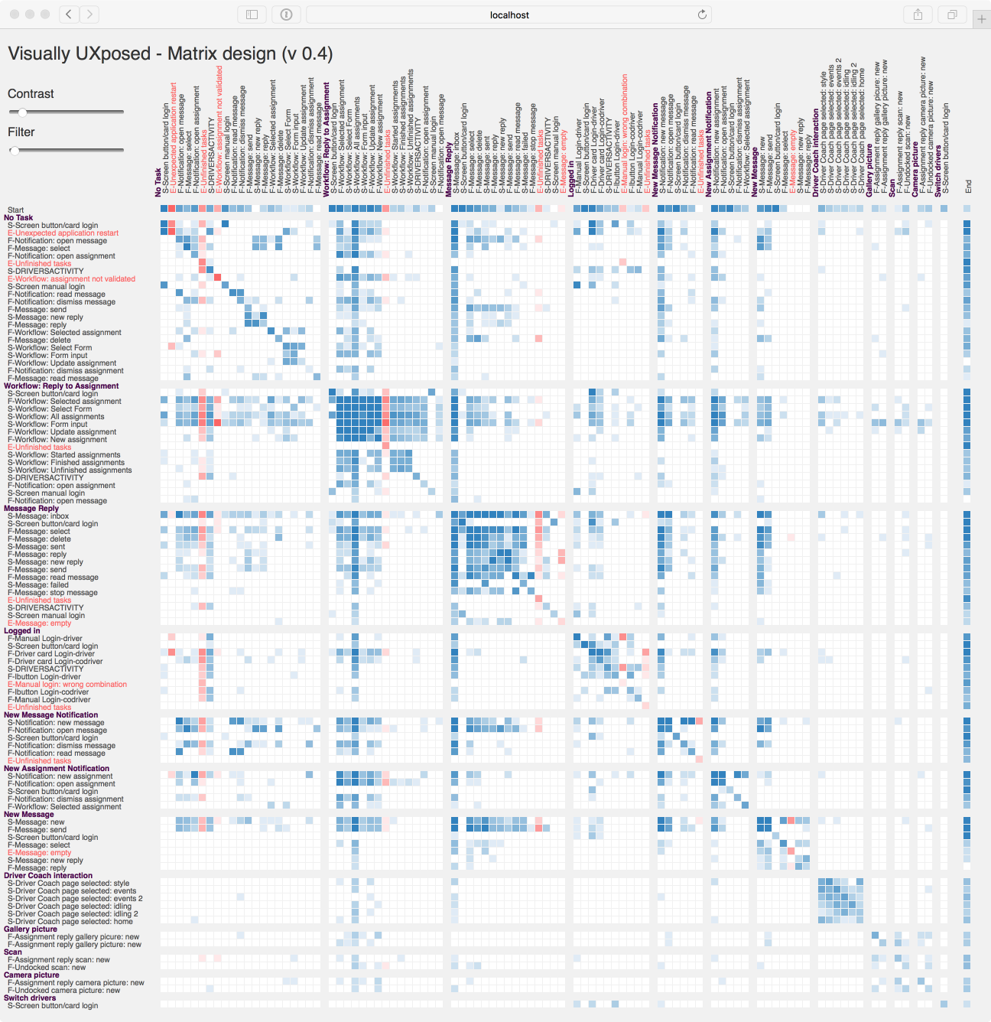
The Matrix

Slide 10
The Matrix
Default
Contrasted
Filtered

Slide 11
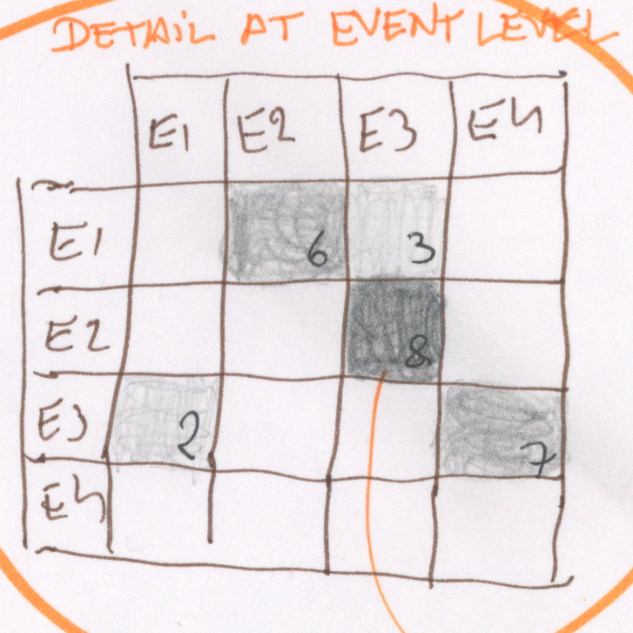
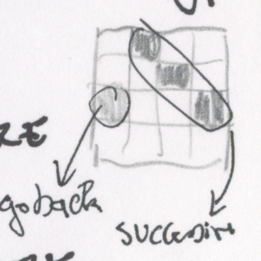
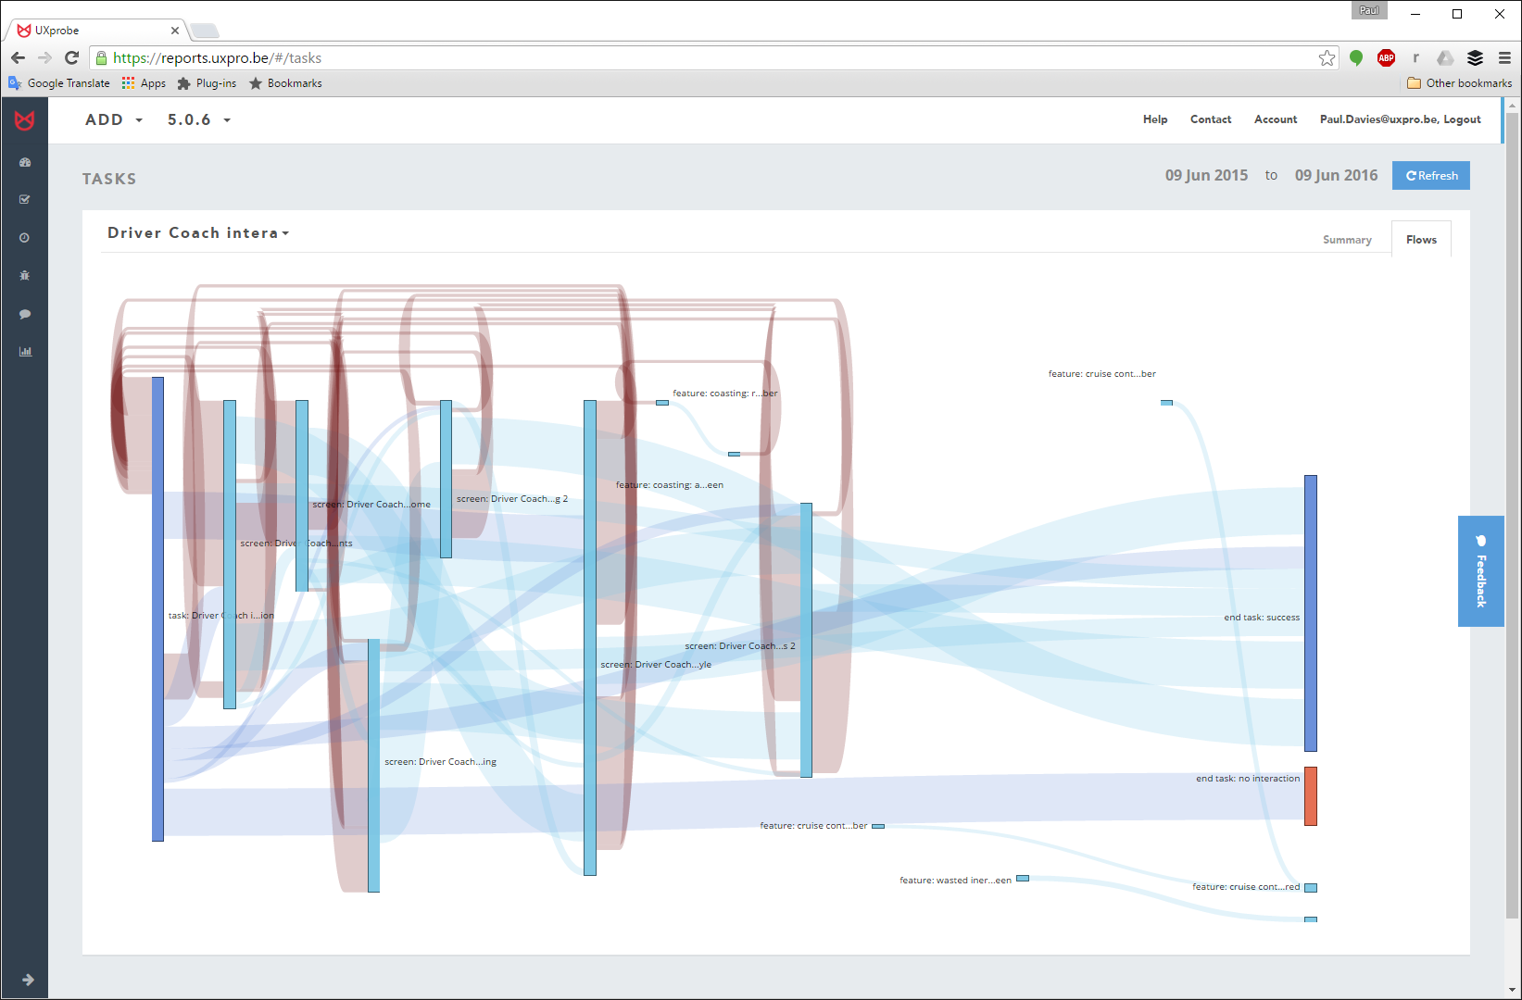
Design Highlights

Slide 12
The Matrices (lots of…)

Slide 13
Back To The Goal
The matrix summarizes the entire application, yet allow for detailed analysis of patterns of use
Complexity and structure of use across and within tasks is immediately perceived
Some patterns of use are remarkable: “pillars”, empty lines, squares, sequences, isolation,…
Errors are highlighted, their frequency, location and possible causes are assessed visually
Miniaturisation still gives overall perception of use and can be uses to contrasts different user clusters or application versions

Slide 14
The Future
Productive implementation???
Improvements
Collapsible tasks
Frequency histograms for the tasks (could be shown along the edges of the matrix)
A master/detail design
Visual aids to easily locate the labels, such as guidelines, highlighting or magnifying the labels corresponding to a cell
Different sorts of sorting.
Use of satisfaction results of the micro-surveys, either as a sorting criterion, or surrounding the task tile, in the fashion of our first design.
Implement in D3

Slide 15
Backup slides

Slide 16
Implementation: Structure
Three stages:
A preprocessing stage: data loading, recoding, cleaning, volume reduction, building data model and relationships, building the network, etc.
A processing stage: preparing the data in the required structure for the visualisation (i.e. the matrix view of the network of tasks and events)
The visualisation stage: drawing the actual visual (the matrix) and interaction (sliders, tooltip)
Technologies:
Swift 2.2 for the preprocessing and processing stages
JavaScript and p5.js library for the final stage

Slide 17
Implementation Issues
Time stamp is in seconds:
as we rely on the time to determine the sequence of events, events are likely to be out of their real sequence, because they appear have the same time.
Some events are system events:
examples: “harsh braking: green => red“, “cruise control: amber => amber”, etc. : they are not initiated by the user

Slide 18
